Slide 1
TENNIS

Slide 2
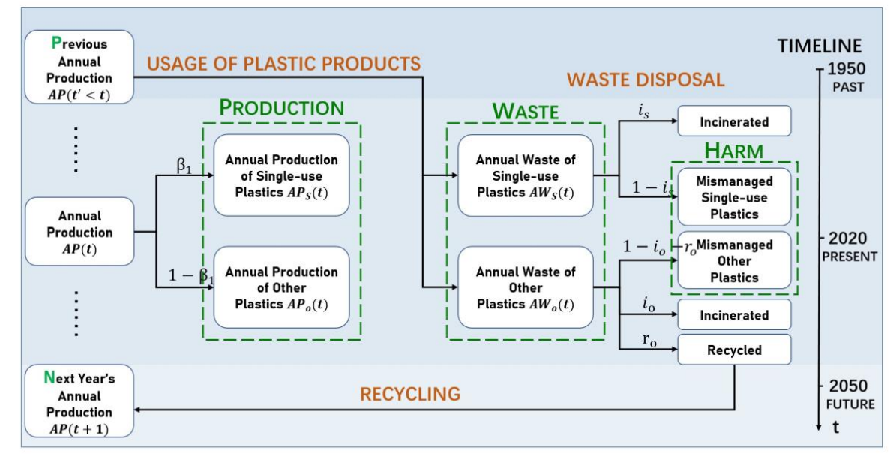
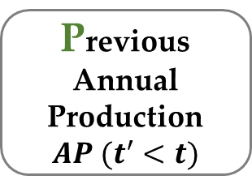
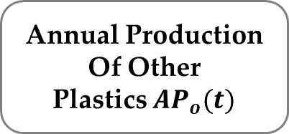
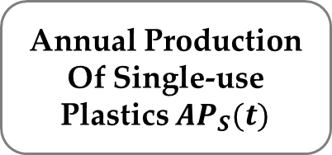
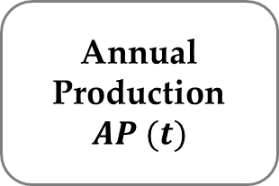
Previous
Annual
Production
$$AP (t^{′}<t)$$
PRODUCTION
Annual Production
Of Single-use
Plastics ${AP}_{S}(t)$
Annual
Production
$$AP (t)$$
Annual Production
Of Other
Plastics ${AP}_{o}(t)$

Slide 3

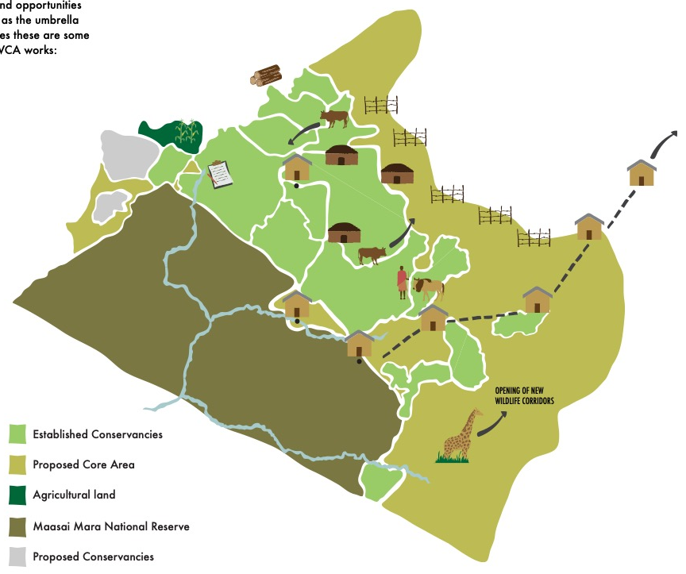


Maasai Mara
Human Society Subsystem
Coupling Area
Land Resource Subsystem
Human-Land
Figure 5

Slide 4
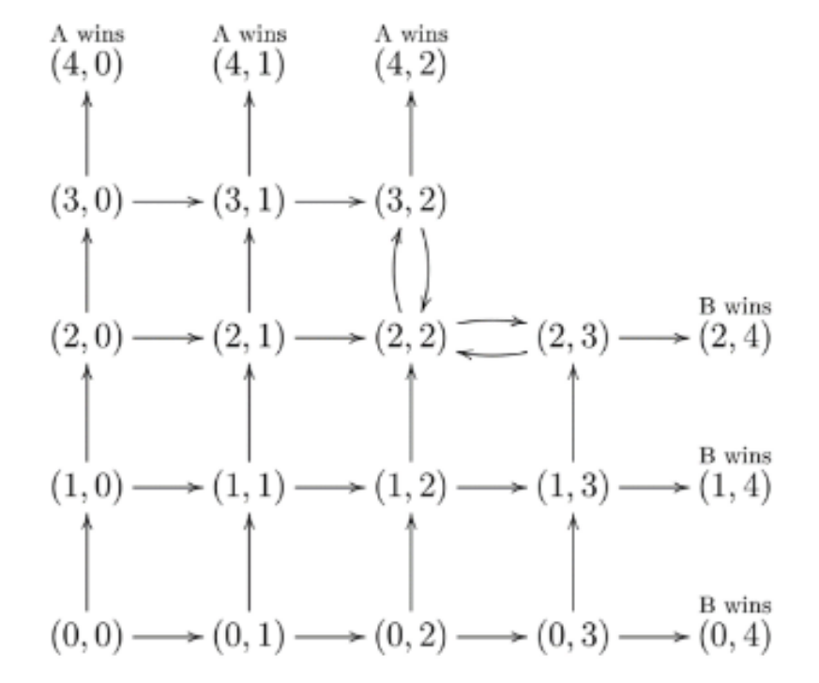
(0,0)
(0,0)
(0,0)
 |  |  | (5,3)
(4,0) | (4,1) | (4,2) | (4,3)
(3,0) | (3,1) | (3,2) | (3,3) | (3,4) | (3,5)
(2,0) | (2,1) | (2,2) | (2,3) | (2,4)
(1,0) | (1,1) | (1,2) | (1,3) | (1,4)
(0,0) | (0,1) | (0,2) | (0,3) | (0,4)
(0,0)
(0,0)
(0,0)
A WINS
(0,0)
(0,0)
(0,0)
(0,0)
(0,0)
(0,0)
(0,0)
(0,0)
(0,0)
B WINS

Slide 5
Training Dataset
Traffic Sign
ResNet-50
Training
RNN
Model
Image
Preprocess
80%
ResNet-101
ResNet-152
Dataset
20%
Testing Dataset
Image
Preprocess
Traffic Sign
Compare with model
AHP
Method
Most Probable Class
Figure 4 Template

Slide 6
Data Group
Features
Distance
Factor 1
Train & Tuning Parameters
Data Cleaning
Standardized
Processing
Factor 2
Scores
Progress
Factor 3
Cross-Validation
Others
…
1000 sets of data for tuning parameters, 5000 sets of data for cross validation
Figure 4

Slide 7
PQYYYYYYY
DSYYYYY
WHKKKKKK
Policies
Strategies
Strategy Evaluation Model
BD
EQ
EB
DI
Figure 7

Slide 8
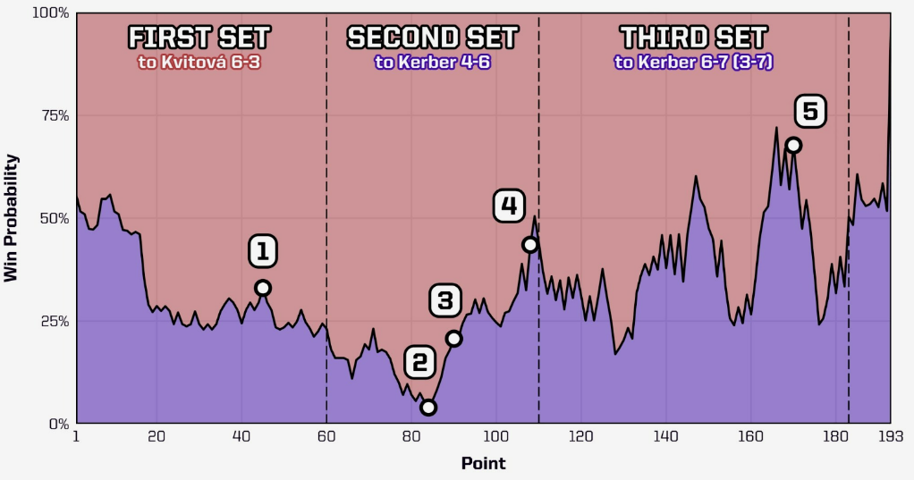


point_no
Point_no
Serve Quality
Time Series
PCA Method
VALUE Group
RATE Group
Lead/Behind
Double fault
Run distance
Features
Unforced error
Winning streak
Break rate
UP Group
……
Net points rate
ACE
Break
Winning streak
Indicators

Slide 9
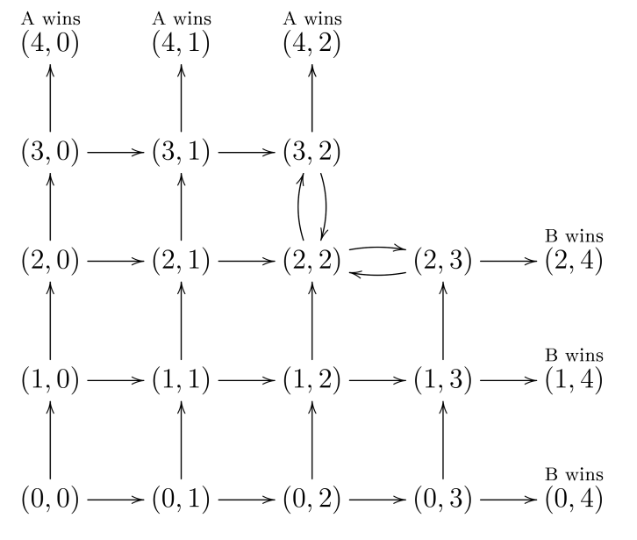
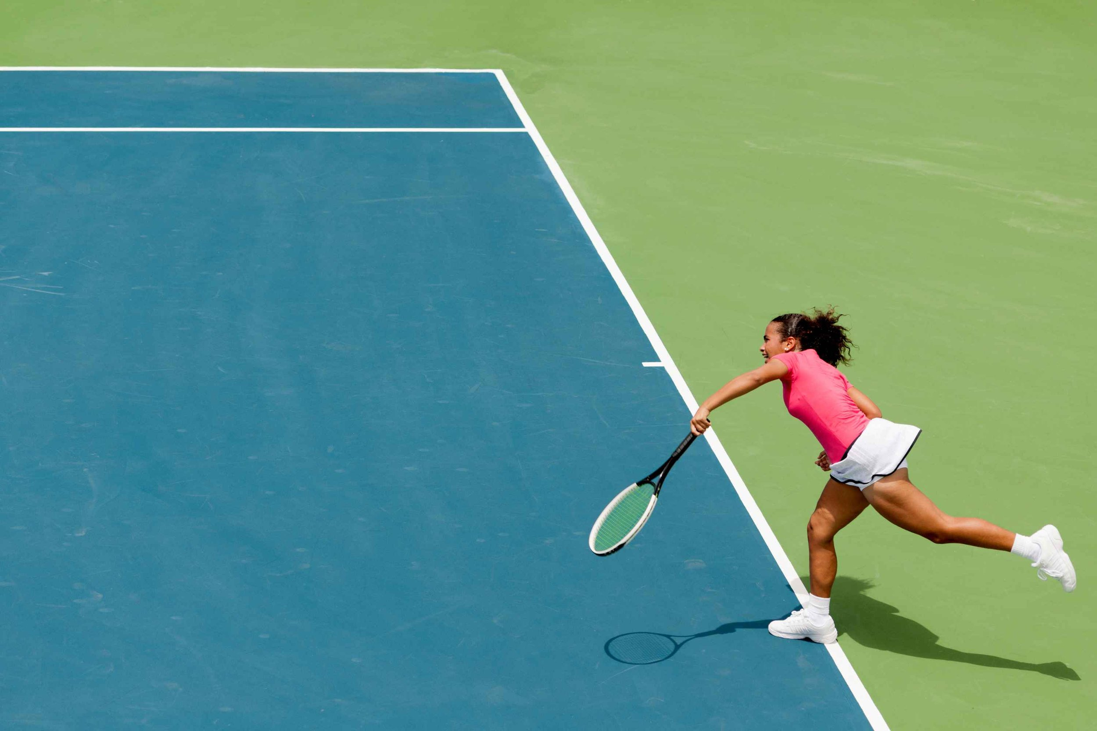

Slide 10


UP Group
DOWN Group
ACE
Double fault
Break
Long duration
Winning streak
Others
……
Momentum
……

Slide 11


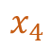
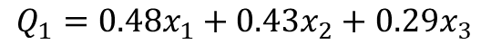

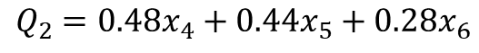
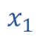
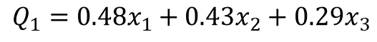
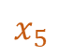
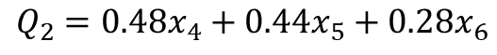
P1-Serve
P1
P2
Serve Pressure
Serve Pressure
Speed
$$x_{1}$$
$$x_{4}$$
Speed
$$x_{2}$$
$$x_{5}$$
Width
Width
$$x_{3}$$
$$x_{6}$$
Depth
Depth
Serve Quality---PCA Method
$$Q_{1}=0.48x_{1}+0.43x_{2}+0.29x_{3}$$
$$Q_{2}=0.48x_{4}+0.44x_{5}+0.28x_{6}$$
$$Q_{1}=0.48x_{1}+0.43x_{2}+0.29x_{3}$$
$$Q_{2}=0.48x_{4}+0.44x_{5}+0.28x_{6}$$

Slide 12
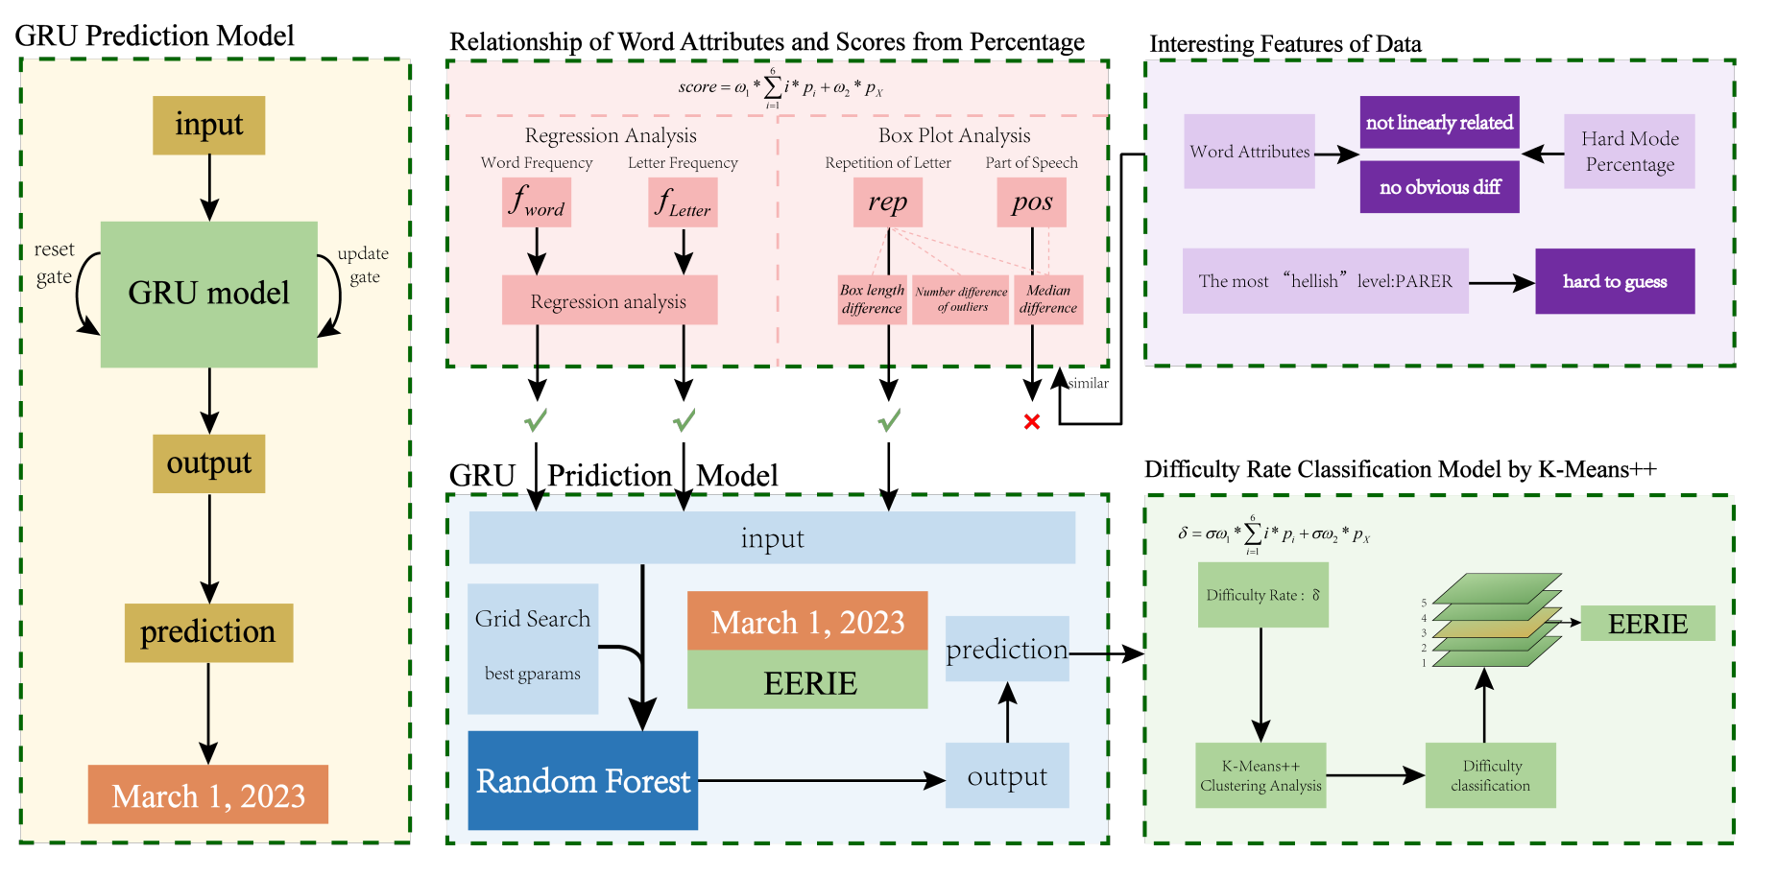
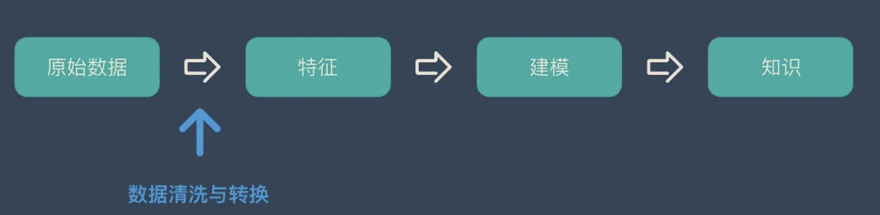

Slide 13


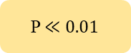
Data Analysis
Stacking Model and Recursive Algorithm
Further Discussion
Serving
P (0,1)
Meta-
Learner
Data Cleaning
Logistic
Score
RF KNN…
Accuracy
Pressure
Game
Physical Duration
Standardized
Processing
GridsearchCV
Tuning Hyper
Set
AUC
0.8341
Advice
Feature Sets
Match
Table tennis
Run Test --- Momentum Exists
Train & Tuning Parameters
Cross-Validation
Courts…
ANOVA
T < 0
P $≪0.01$
Non - random
Women

Slide 14
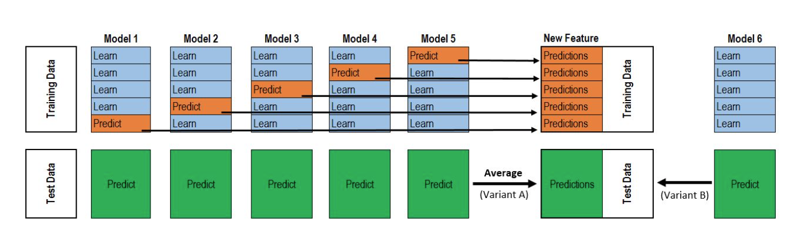
cross——validation
Learn
Learn
Learn
Learn
Predict
Predictions
Learn
Learn
Learn
Learn
Predict
Learn
Predictions
Learn
Learn
Learn
Predict
Learn
Learn
Predictions
Learn
Learn
Predict
Learn
Learn
Learn
Predictions
Learn
Predict
Learn
Learn
Learn
Learn
Predictions
Learn
Predict
Predict
Predict
Predict
Predict
Predictions

Slide 15
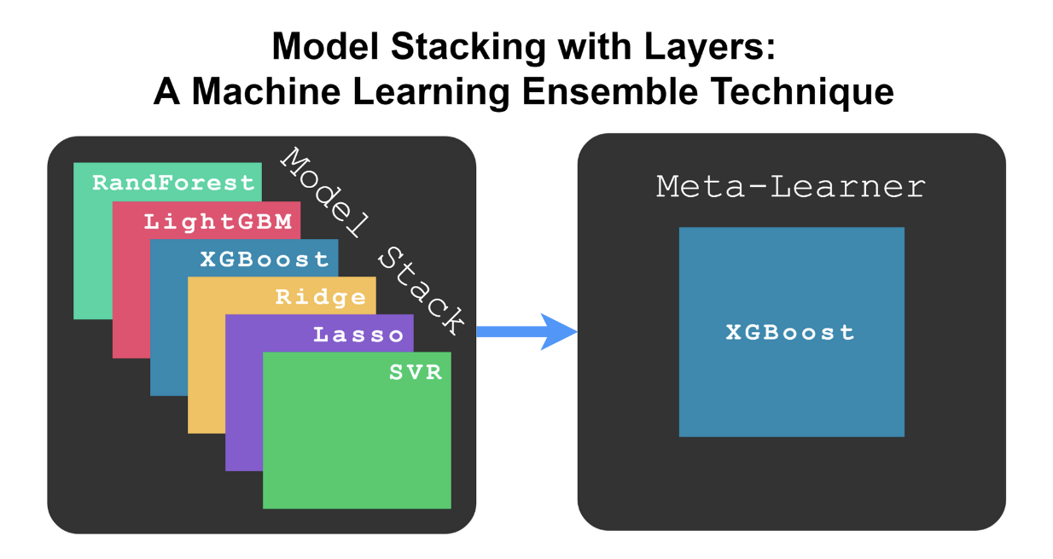
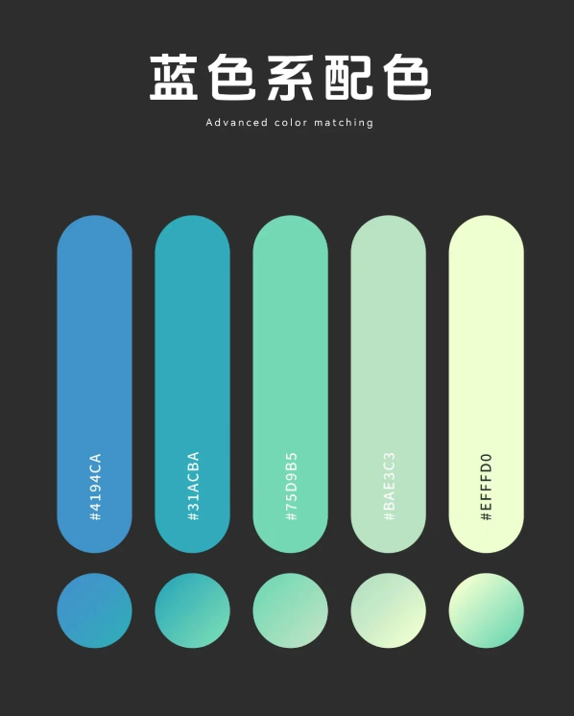
RandForest
AdaBoost
CatBoost
ExtraTrees
GB&KNN
MLP
GridSearchCV
Hyperparameter Tuning
RandomForestClassifier，AdaBoostClassifier，CatBoostClassifier， MLPClassifier(多层感知机)，ExtraTreesClassifier，Gradient Boosting Classifier，KNN
Area Under the Curve (AUC) metric
Evaluate the training effectiveness.

Slide 16
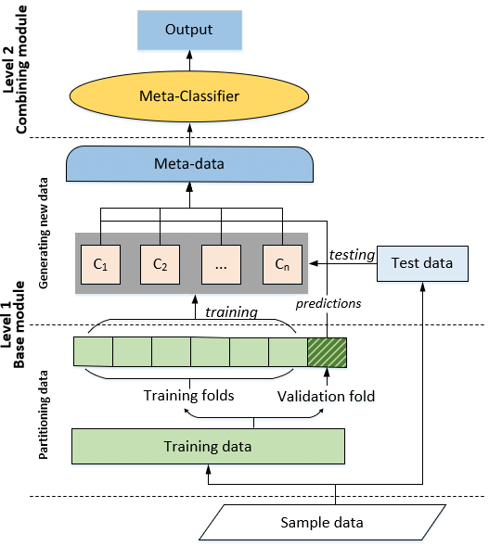

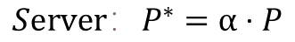
Stacking Model
$$P_{sc}$$
Score
Winning Probability
$$P_{G}$$
Game
Set
Score
Match
Game
$$P_{se}$$
Set
Score
$$P_{M}$$
Match
Game
Set
Score
$${Server：P}^{∗}=α⋅P$$
Match
Game
$$Adjust$$
Set
Recursive Algorithms
Match

Slide 17
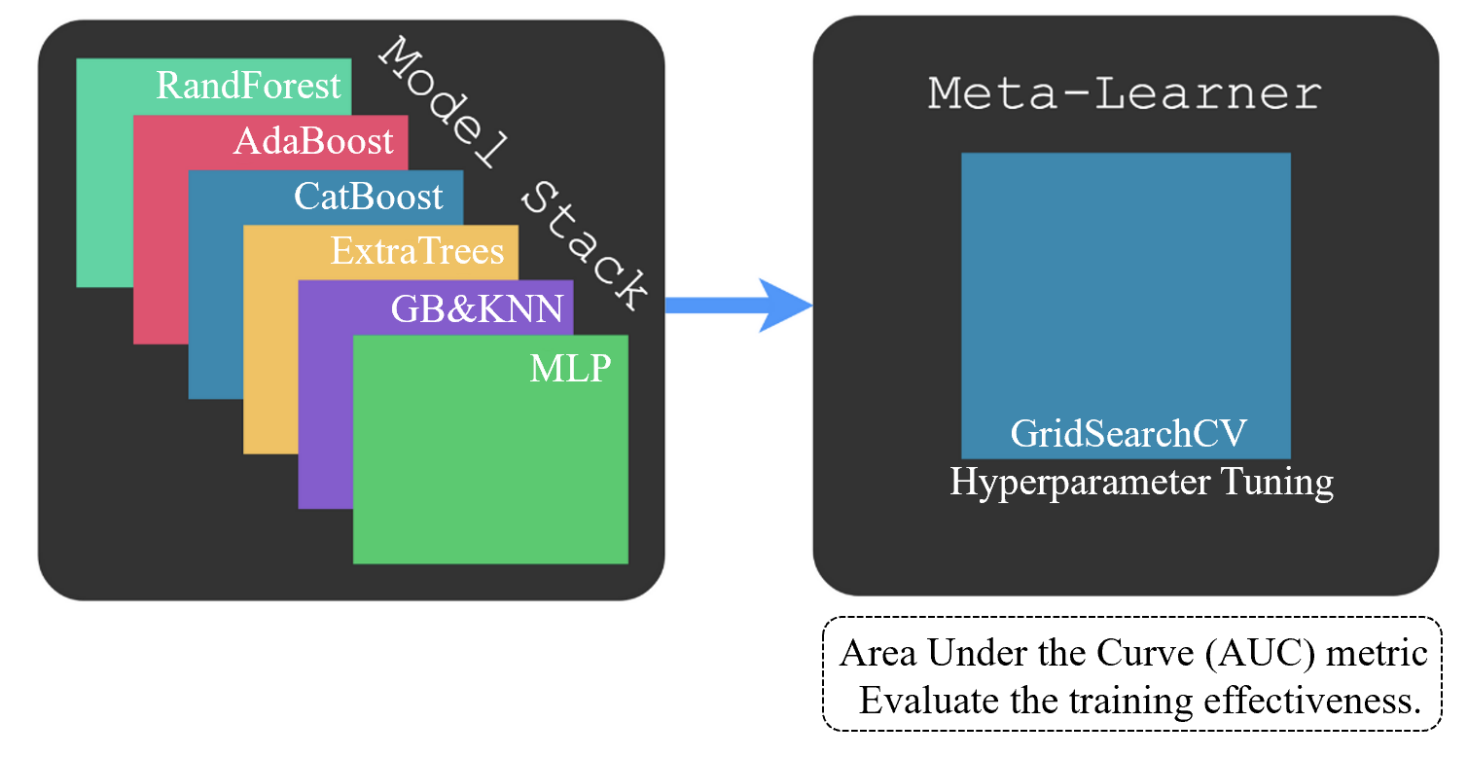
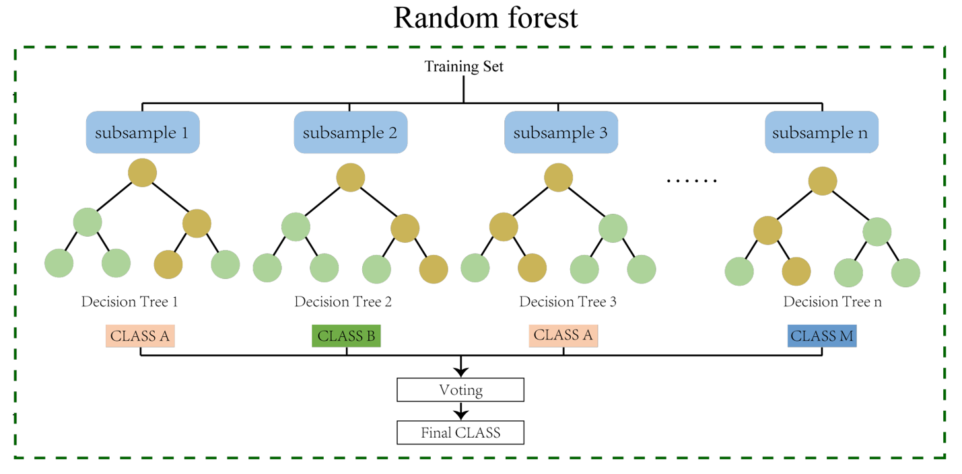
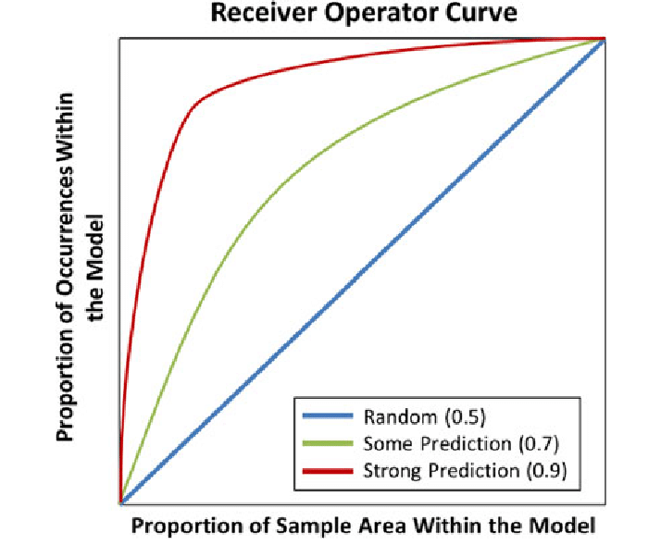

Slide 18
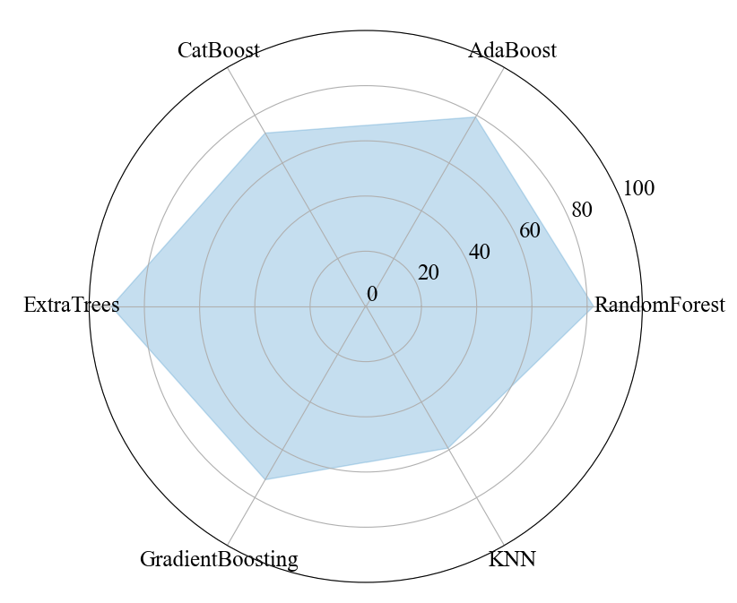

Slide 19
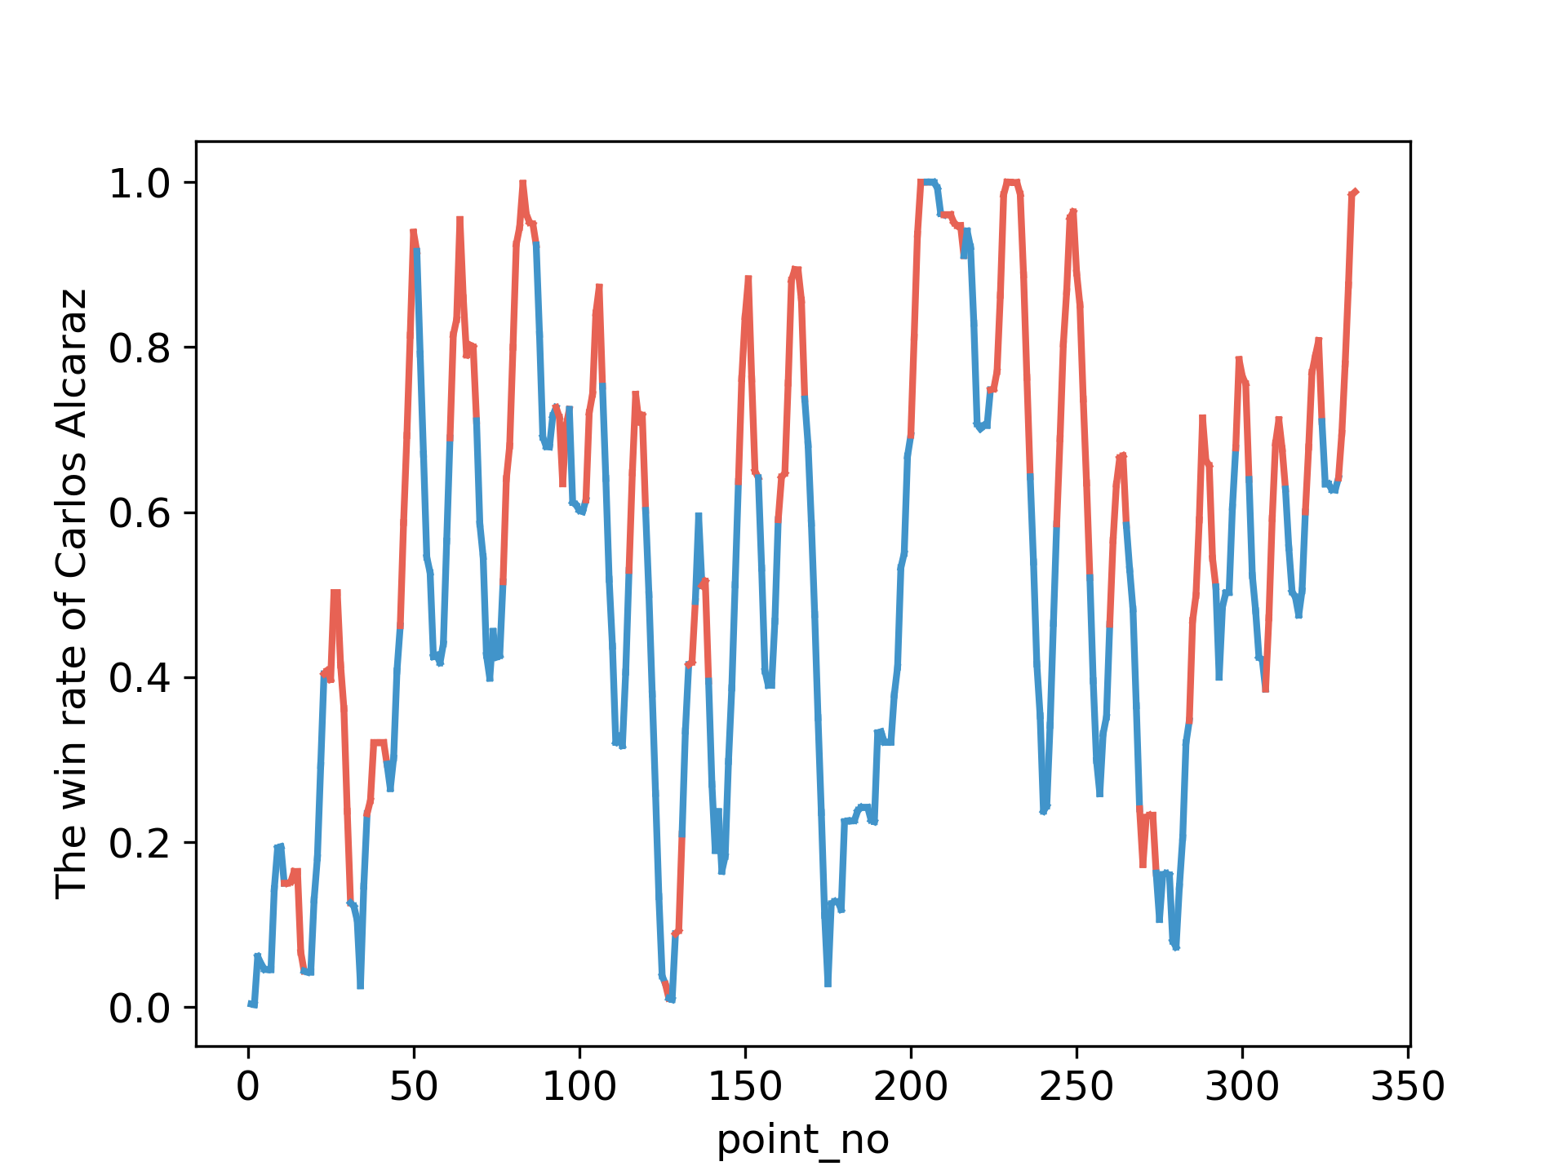
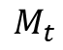
$$M_{t}$$
Server
Carlos Alcaraz
Server
Novak Djokovic

Slide 21
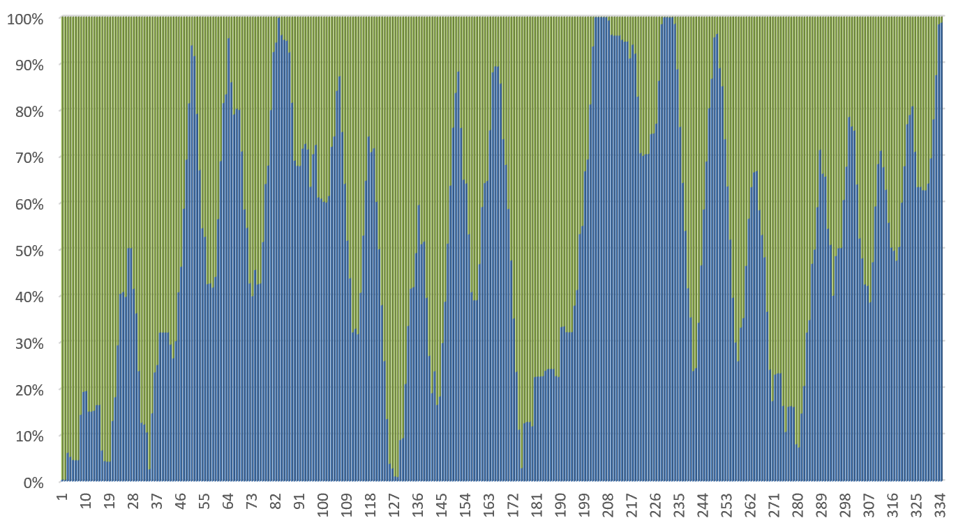

Slide 22
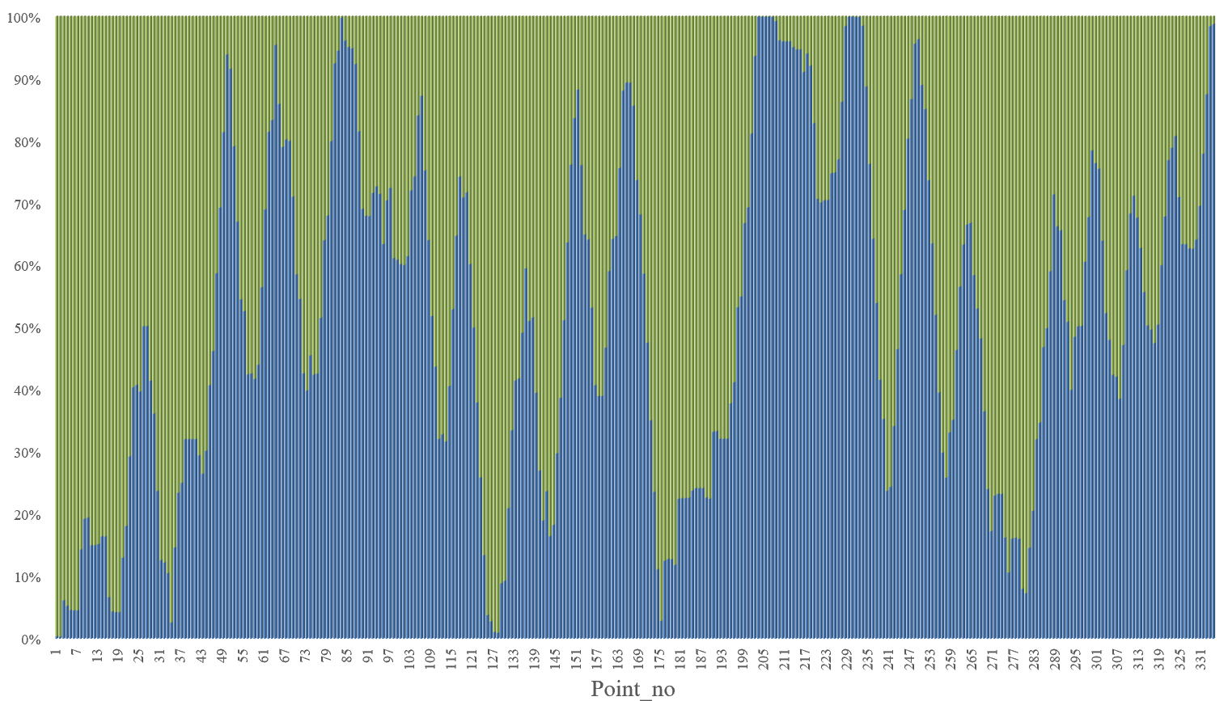
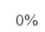
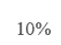
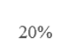
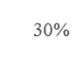
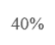
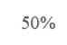
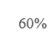
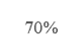
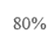
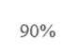
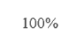
Novak Djokovic
Server
Carlos Alcaraz
Server
Novak Djokovic
Carlos Alcaraz
a) Visualization of Momentum of Alcaraz
b) Contrasting the match momentum

Slide 23
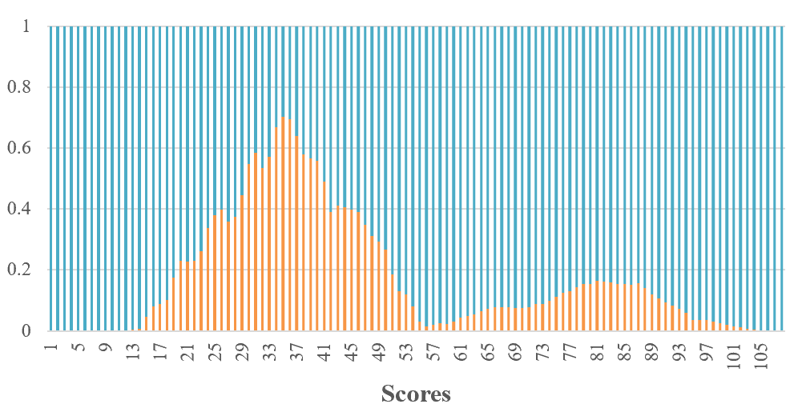
Ma Long
50%
Fan Zhendong

Slide 24
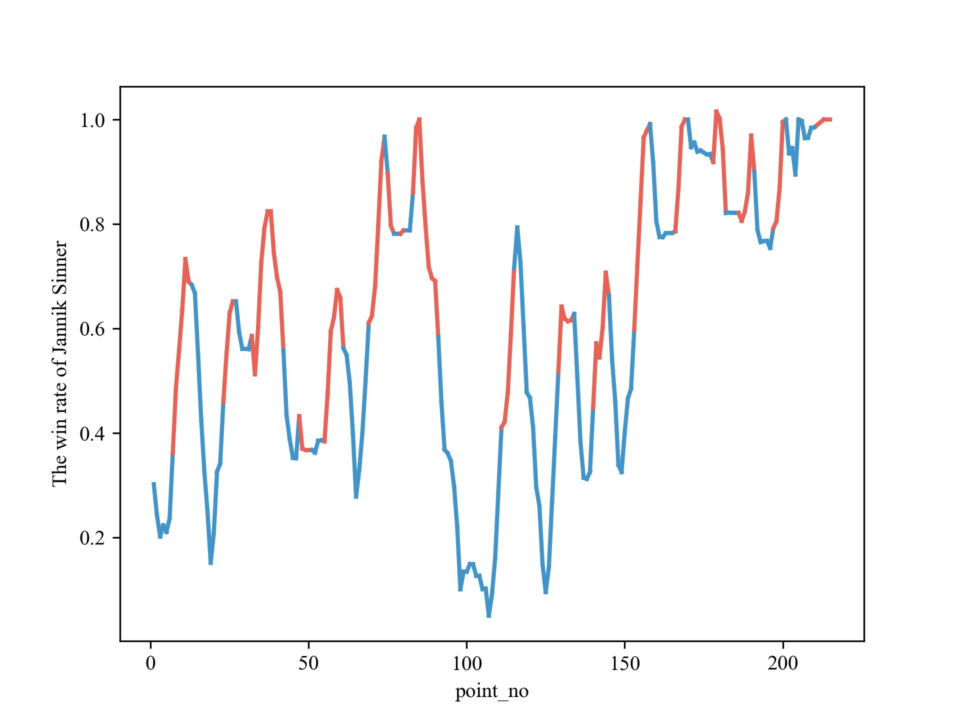
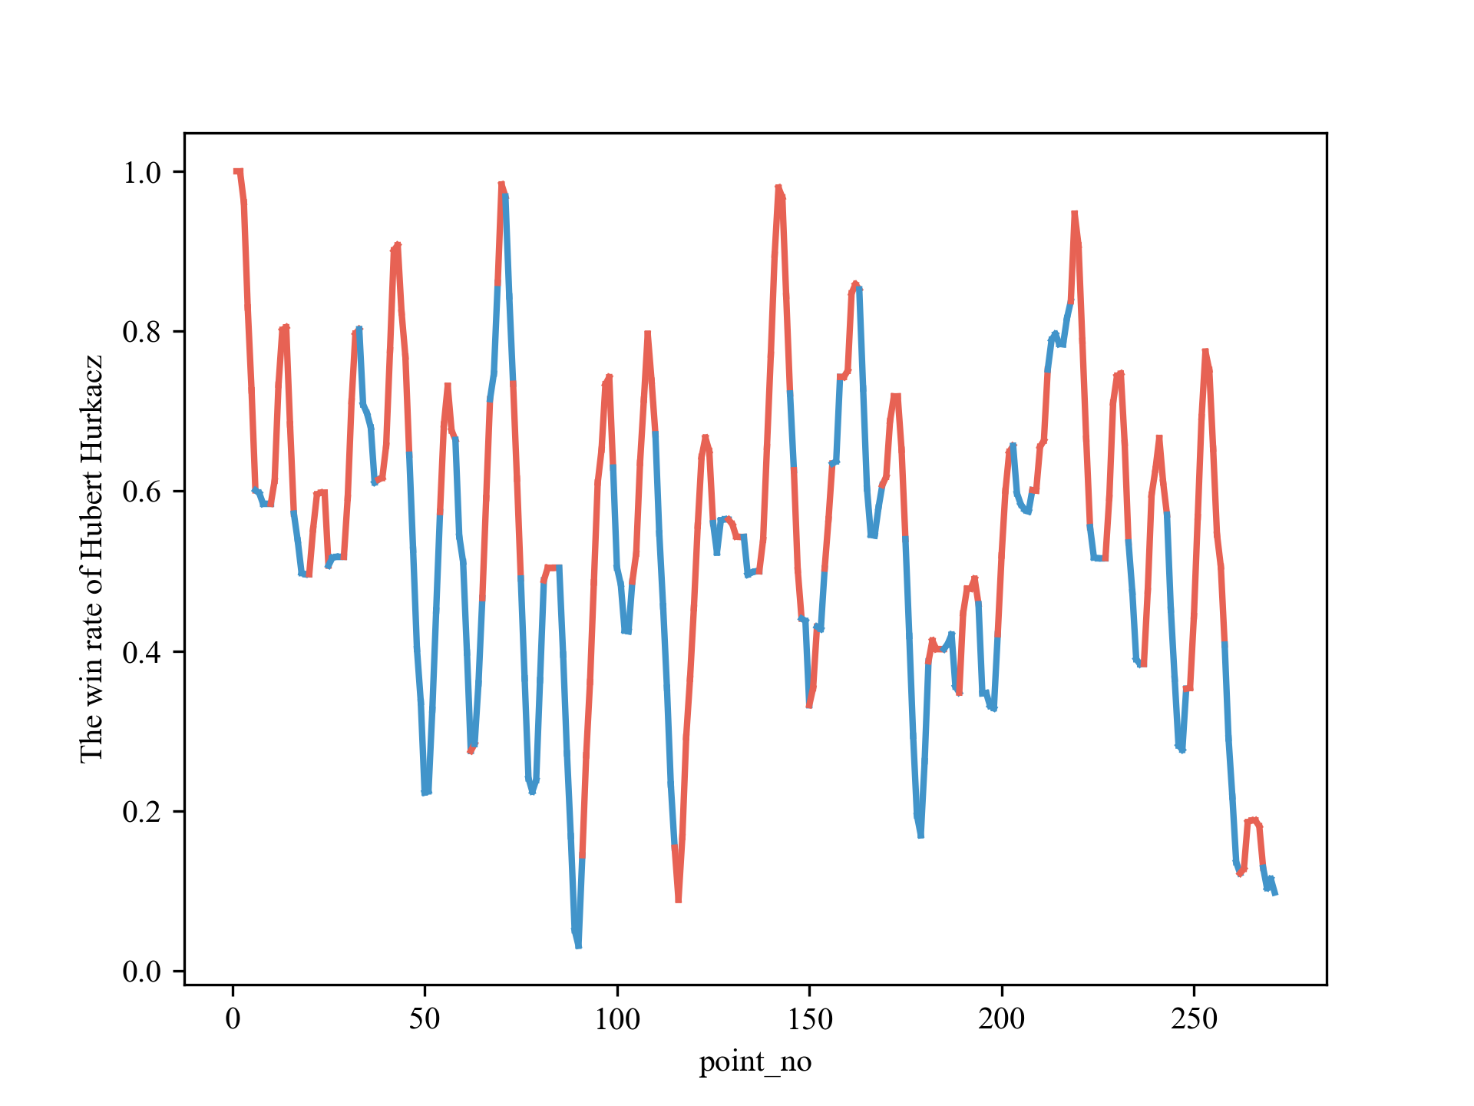
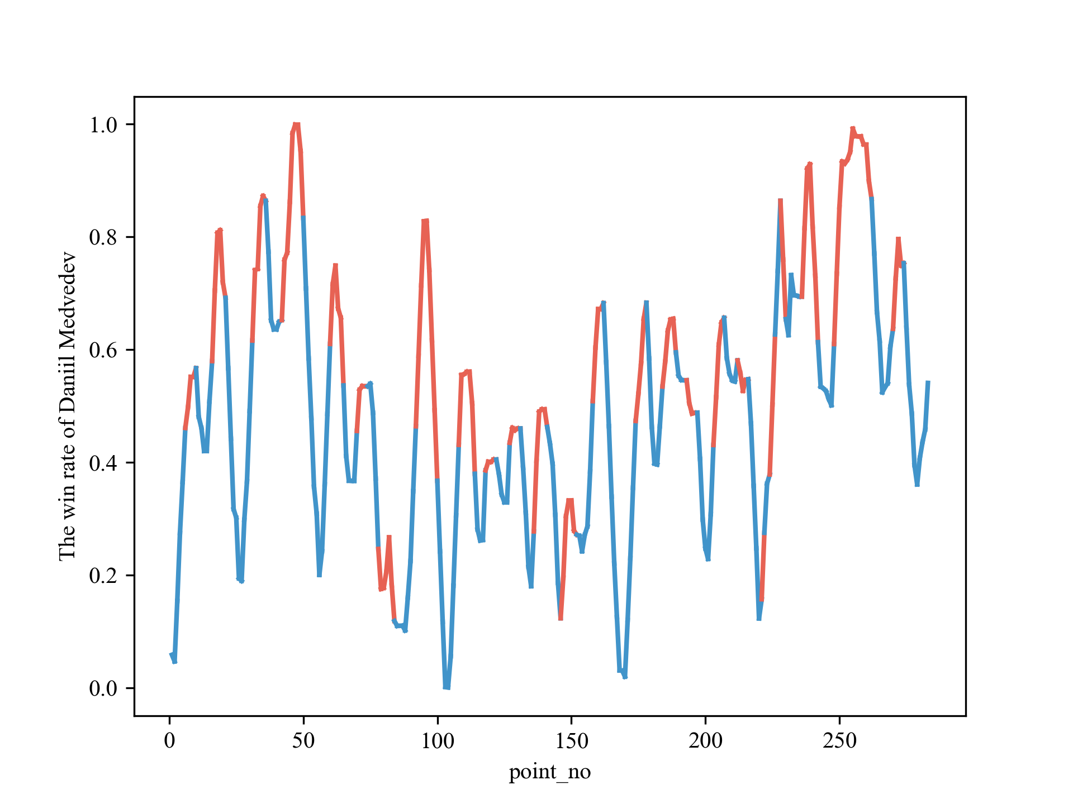
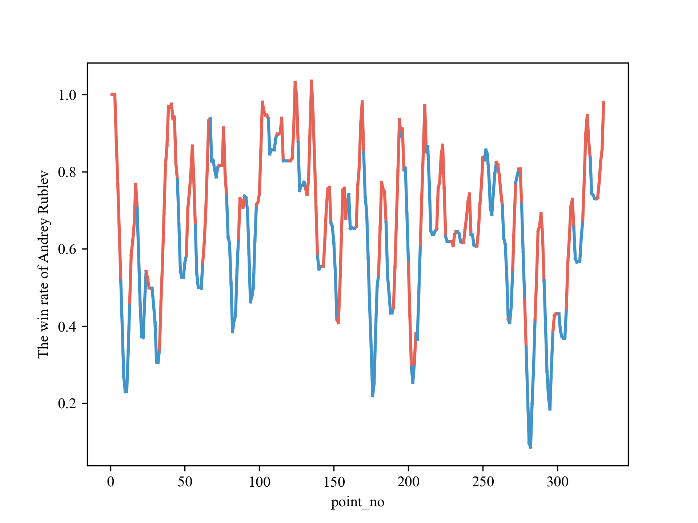
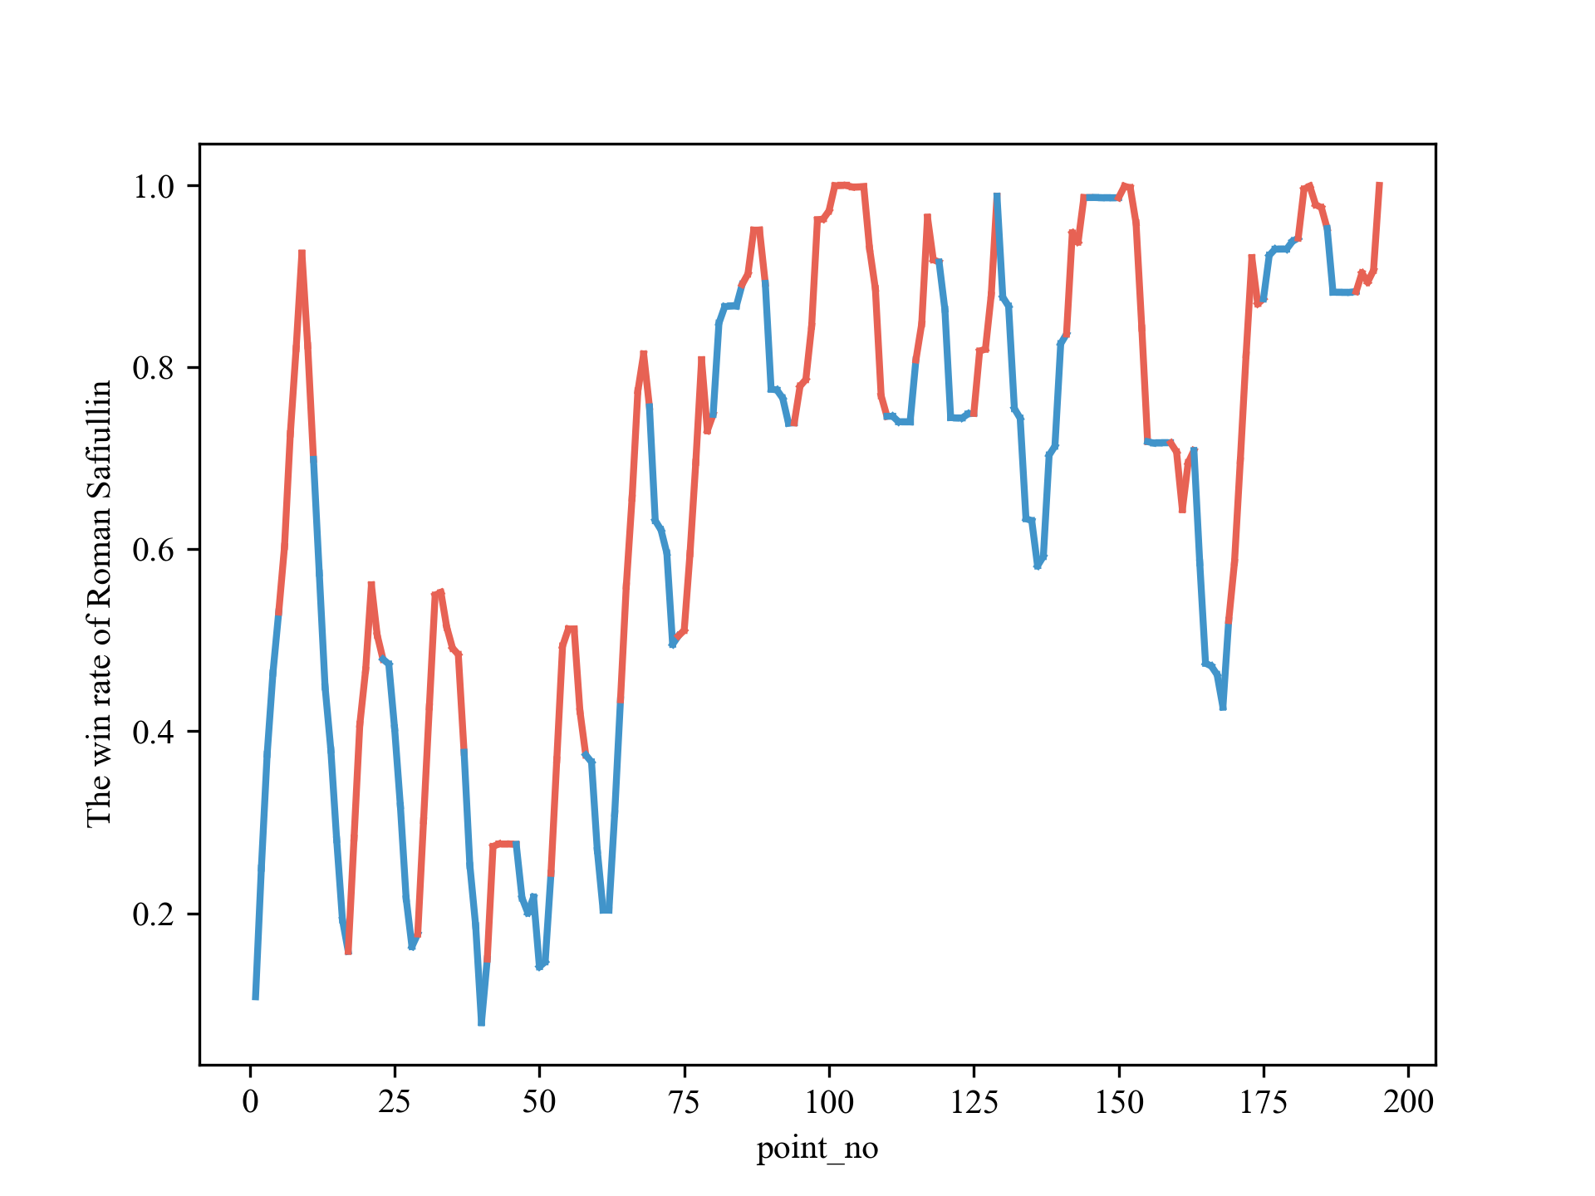


Slide 25





Slide 26



